Slide 1
Weather Dataset Aarhus Denmark DS-670
Rhonald Reside
Assignment 6 - Proposal

Slide 2
Content
Novel Contribution
Work By Competitors
Data
Data Visualization
Method

Slide 3
PROPOSAL
Use Logistic Regression to find the relationship between Temperature, Humidity and Dewpoint.
Used the ISLR library in R

Slide 4
Novel Contribution
Create a full logistic model using temperature, Dew Point, Humidity, pressure and wind direction.
Create a training data set and a testing data set
Use different tools to analyze data to show how a story was created.

Slide 5
METHOD
Data Aggregation (Downloading and Uploading)
Data Cleansing (Excel)
Data Modeling (Dependent on the tool used)
Data Analysis (R, Zeppelin, Tableau, MS Excel)
Findings (Tableau)
Conclusion (Zeppelin, R, Tableau)

Slide 6
Work by competitors
Competitor’s Article: “The Relationship between Relative Humidity and the Dewpoint Temperature in the Mount Air”
How are the dewpoint temperature and relative humidity related
Is there an easy and sufficiently accurate way to convert between them without using a calculator

Slide 7
Reference
Lawrence, Mark G (2005). The Relationship between Relative Humidity and Dewpoint Temperature in Moist Air : A Simple Conversion and Applications: Bulletin of the American Meteorological Society: Vol 86, No 2. Journals.ametsoc.org http://journals.ametsoc.org/doi/abs/10.1175/BAMS-86-2-225

Slide 8
Work by Competitors
The authors first defines what is relative humidity and how temperature, humidity and dew point reacts to each other.
Then the authors then provides a few theoretical equations on how the dependent variables (i.e. dew point and humidity) correlate with an independent variable temperature.
The author calculates the equation by hand and give his error rate in the end.

Slide 9
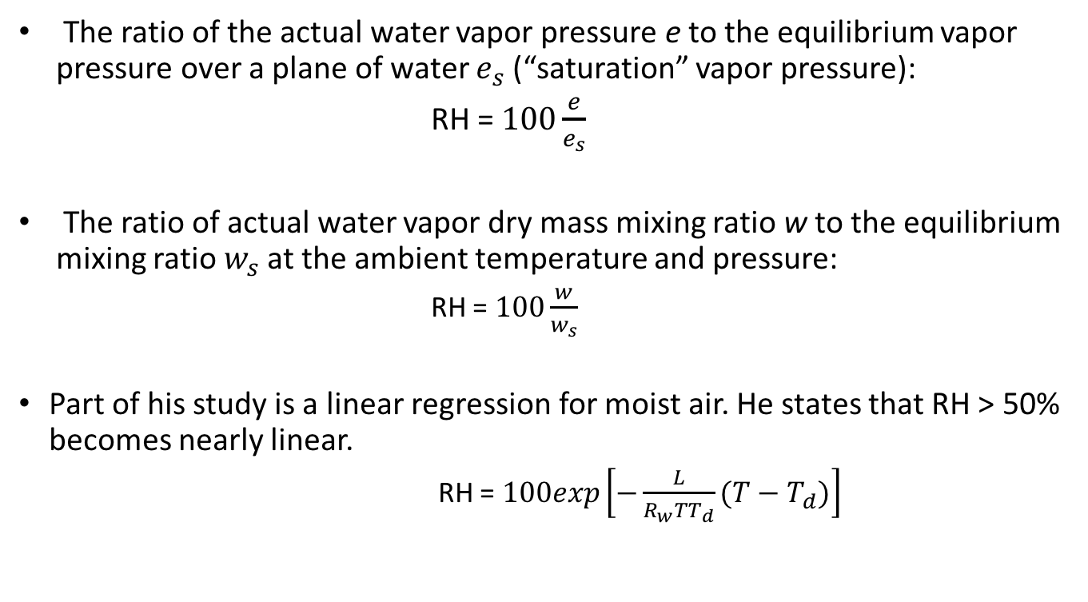
WORK BY COMPETITOR
The ratio of the actual water vapor pressure e to the equilibrium vapor pressure over a plane of water $e_{s}$ (“saturation” vapor pressure):
RH = $100\frac{e}{e_{s}}$
The ratio of actual water vapor dry mass mixing ratio w to the equilibrium mixing ratio $w_{s}$ at the ambient temperature and pressure:
RH = $100\frac{w}{w_{s}}$
Part of his study is a linear regression for moist air. He states that RH > 50% becomes nearly linear.
RH = $100exp\left[−\frac{L}{R_{w}TT_{d}}(T−T_{d})\right]$

Slide 10
Data
Weather data set came with seven different types of variable.
It came in with Dew Point, which was in degrees Celsius.
Humidity was the next variable which came in percentage.
Pressure was the next variable which came in the measurement of mBar.
Temperature was the next variable which was measured in degrees Celsius.
Wind direction was the next set of variables which was came in the measurement of degrees.
Wind speed is the next variable, which was measured in kilometers per hour.
The final variable was visibility.

Slide 11
Data
The weather data is separated by two sets of dates.
The first range of the weather data set is February 2014 to June of 2014.
The second set of the weather data set is in August 2014 to September 2014.

Slide 12
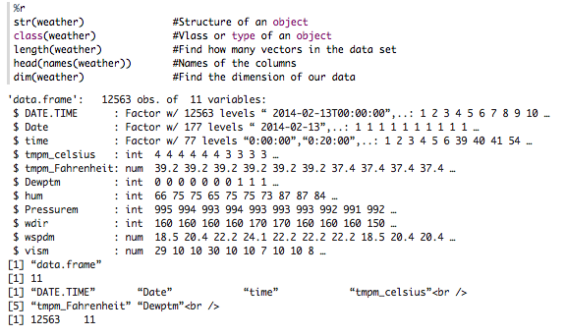
DATA 1

Slide 13
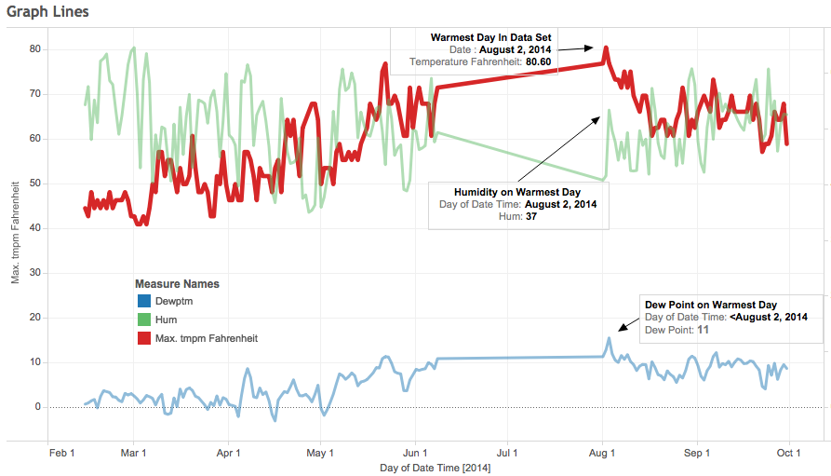
DATA 2

Slide 14
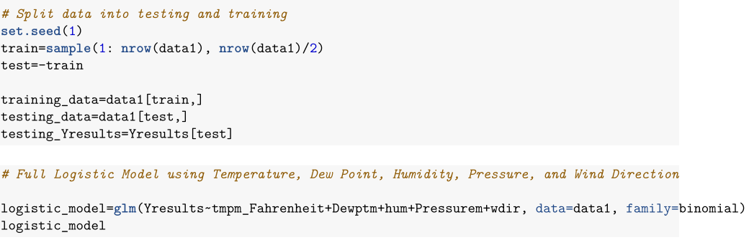
DATA 3

Slide 15
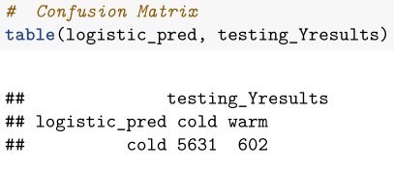
DATA 4

Slide 16
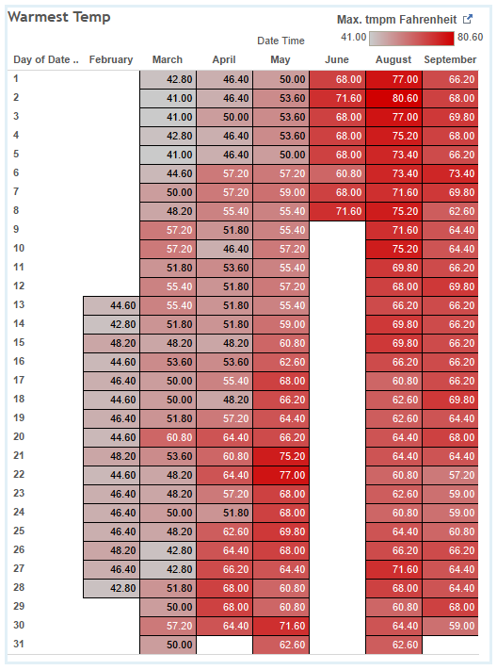
DATA
Heat map for data visualization of warmest day.

Slide 17
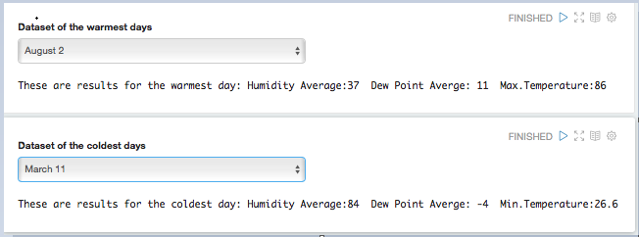
DATA

Slide 18
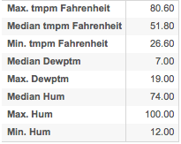
DATA

Slide 19
Method
Data Aggregation (Downloading and Uploading)
Data Cleansing (Excel)
Data Modeling (Dependent on the tool used)
Data Analysis (R, Zeppelin, Tableau, MS Excel)
Findings (Tableau)
Conclusion (Zeppelin, R, Tableau)

Slide 20
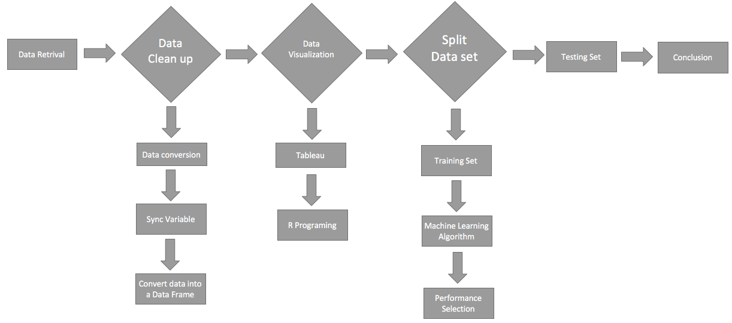
Work Flow Chart

